Slide 1
Java Architecture and OOPs Concept
Pavan P

Slide 2
Introduction
Java Architecture is a collection of components, i.e., JVM, JRE, and JDK..
It integrates the process of interpretation and compilation.
It defines all the processes involved in creating a Java program.
Java Architecture explains each and every step of how a program is compiled and executed.

Slide 3
Java Architecture
Java Architecture can be explained by using the following steps:
There is a process of compilation and interpretation in Java.
Java compiler converts the Java code into byte code.
After that, the JVM converts the byte code into machine code.
The machine code is then executed by the machine.

Slide 4
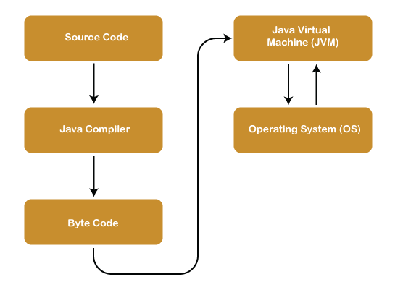
Java Architecture

Slide 5
Java Virtual Machine
The main feature of Java is WORA. WORA stands for Write Once Run Anywhere.
It is a Java platform component that gives us an environment to execute java programs.
JVM's main task is to convert byte code into machine code.
JVM, first of all, loads the code into memory and verifies it. After that, it executes the code and provides a runtime environment.

Slide 6
Java Runtime Environment
It provides an environment in which Java programs are executed.
JRE takes our Java code, integrates it with the required libraries, and then starts the JVM to execute it.

Slide 7
Java Development Kit
It is a software development environment used in the development of Java applications and applets.
Java Development Kit holds JRE, a compiler, an interpreter or loader, and several development tools in it.

Slide 8
OOPs Concepts
The four main pillars of OOPs are:
Inheritance
Polymorphism
Abstraction
Encapsulation

Slide 9
OOPs Concept
Object: Any entity that has state and behavior is known as an object.
Class: Collection of objects is called class.
Inheritance: When one object acquires all the properties and behaviors of a parent object.
Polymorphism: If one task is performed in different ways, it is known as polymorphism.

Slide 10
OOPs Concept
Abstraction: Hiding internal details and showing functionality
Encapsulation: Binding (or wrapping) code and data together into a single unit

